Slide 1
7. Congress
Breakout Sessions
POLS 1101
12:40pm-1:30pm Park Hall 145
& 1:50pm-2:40pm Leconte Hall 135
SIYUAN (Siri) ZHAO
Siri.Zhao@uga.edu
Notes:
Today we re going to talk about

Slide 2
Exam Hand Back
Add points wrong
  WITHIN TODAY (Friday)
Questions on why I lost points in short-answers
  Tomorrow (Saturday)
Appeal your grade
  48 hours later (Sunday)
  Do as told by the syllabus
    You must write a statement to have the assignment regraded saying why you believe you should have received more credit and you will need to give me your blue book.
    If you appeal your grade, I (your TA) will need to regrade which could result in a higher grade, a lower grade, or no change at all.
    Only submit an appeal if you are sure that you can make a strong case for a higher score!
    If you are still unsatisfied with your grade after that, you can repeat the process with Professor Nicholson.

Slide 3
The Origin and Powers of Congress
The origin of Congress came as a balance of benefits between large and small states – the Senate for equal representation (small), the House for large ones.
How are members of congress elected?
  The Senate: 17th Amendment -> direct election by popular vote
  The House: directly based on population -> reapportionment (after each census, the redistribution of representatives among the states based on population change)
Powers
  The Senate: to approve major presidential appointments and treaties with foreign nations
  The House: the power of impeachment (the formal charging of a government official with serious crimes)

Slide 4
Electing Congress
The Incumbency Effect – Centralization of resources; Seniority matters!
  Redistricting: Strategic redistribution of representatives - gerrymandering
  Name recognition
    Franking privilege: the right to send mass communications at taxpayer expense
    Use of social media: What do you think of political stars’ use of social media? Is it good or bad / substantive or just a performance?
  Casework: Solving problems in person for constituents
  Campaign financing
Successful challengers: Also some kind of “centralization”
  “Vulnerable incumbents bring out higher-quality challengers.”
Whom do we elect? – Most are upper-class professionals.
  Elite theory? Does majoritarian democracy always lead to elite ruling?
  Descriptive representation: Legislature should resemble the demographic characteristics of the population it represents.

Slide 5
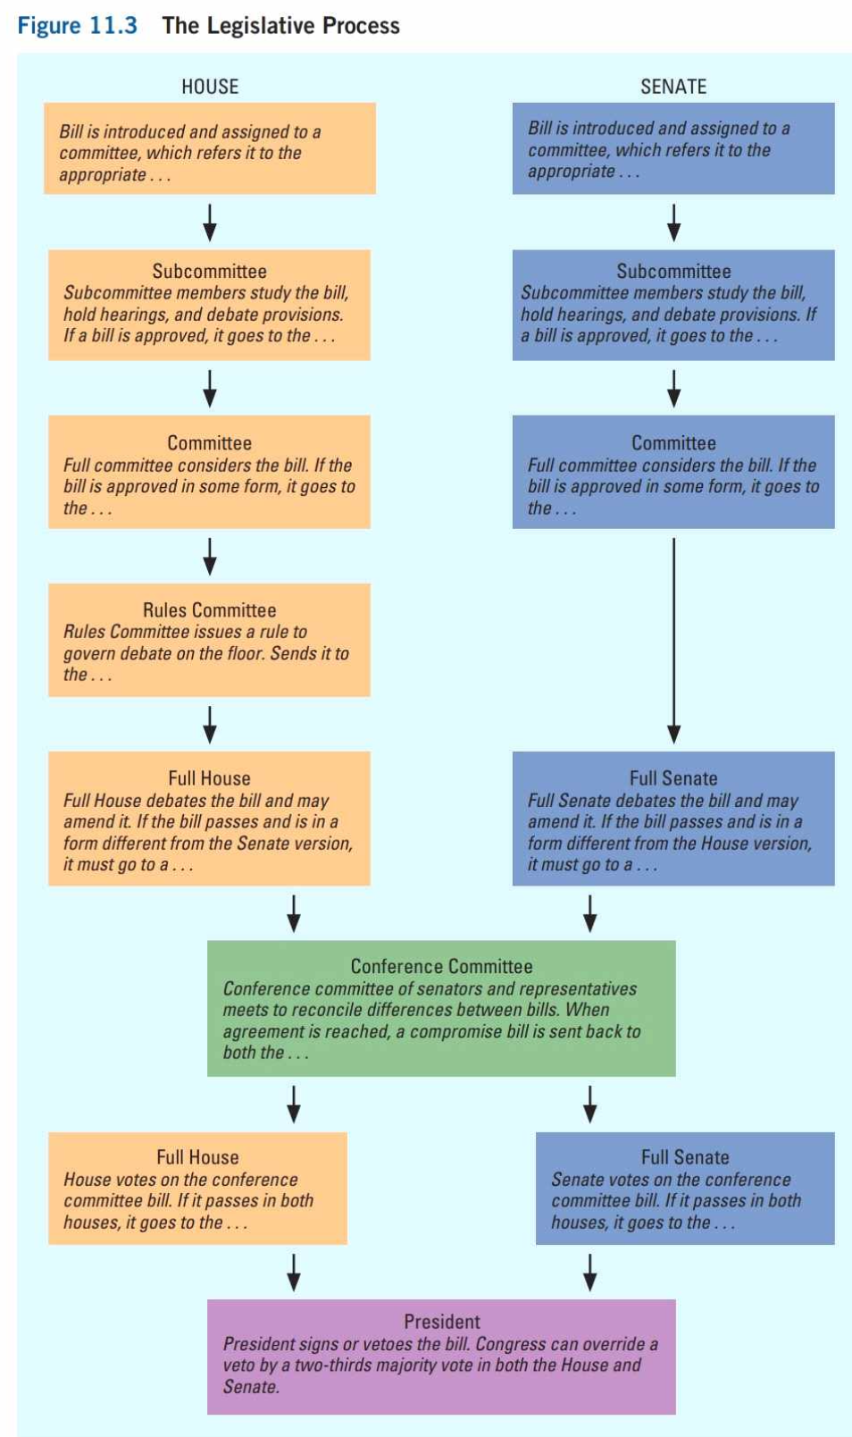
How does Congress work?
Agenda Setting
Bill introduced
Committee & subcommittee -> specific expertise
  “Congress in session is Congress on public exhibition, whilst Congress in its committee-rooms is Congress at work.”
    Markup sessions: the meetings at which subcommittees and committees actually debate and amend legislation.
    Why can members of Congress be usually willing to discuss and negotiate?
  Committees
    Standing committees (permanent)
    Joint committee: made up of members of both the House & the Senate, for fact finding or publicizing issues
    Select committee: for specific, (temporary) purposes
    Conference committee: rare in practice

Slide 6
How does Congress work? (cont`d)
Leadership
  The House: Speaker of the house, majority / minority leader / whip
  The Senate: Vice president (rarely present), President pro tempore (honorary), majority leader (actual power holder)
Rules of procedure
  Major differences between the House & the Senate
    Amendments: directly relevant to the bill at hand v. they can be irrelevant
    Floor debate governing: Rules committee v. unanimous consent agreements
    Length of debate: Only the speaker & minority leader can speak more than 1 hour v.
      Filibuster: A delaying tactic used in the Senate that allows any senator to prevent a bill from coming to a vote.
      Cloture: The mechanism by which a filibuster is cut off in the Senate.
      Hold: A letter requesting that a bill be held from floor debate, which signals filibuster.
  Great efforts in coordination -> centralize the authority of party leaders
    Is the centralization of power an inevitable result of high coordination costs?

Slide 7
How does Congress work? (cont`d)
Stakeholders in legislation
  Political Parties: leading to majoritarianism
    As a reward to loyalty, those who vote in line with the party can get better assignments.
    Partisan polarization leads to harder procedures for a bill to be passed or revised.
      The House majority -> closed rule, which only allows amendments to come from the committee that brought the bill to the floor of the chamber.
      The Senate majority -> “filling the amendment tree”, which allows the majority leader to propose all permissible amendments to a post-cloture bill on the floor, preventing the minority party from altering the bill.
  President: leading to majoritarianism
    Extension of presidency in the legislative process (“chief legislator”)
  Constituents: leading to pluralism
    The diversity of America is mirrored by the geographical basis of representation in Congress. Constituencies push and pull Congress in many different directions.
  Interest groups: leading to pluralism
    Lobbies

Slide 8
Majoritarian & Pluralist democracy in Congress
Majoritarian
  Representatives & senators are directly elected. Most committees reflect the general ideological profiles of the two parties’ congressional contingents.
  One view: Congress members are trustees of their constituents. (They aren’t obliged to vote according to their constituents’ views if they think it wrong.)
  When legislators act as trustees, policymaking becomes less tied to the narrower interests of districts and states. (more majoritarian)
    However, … can be more tied to partisanship
  Both parties can have similar policy focus (e.g. reduction in deficits).
Pluralist
  Another view: Congress members are delegates of their constituents. (faithfully reflect the majority will of constituents)
  When legislators act as delegates, congressional policymaking is more pluralistic.
  However, when it comes to distribution of benefits, legislators can turn to what they can do for their district or state.

Slide 9
Discussion: Delegates or Trustees?
Abortion legislation
Climate Change & Environmental Regulation
Marijuana Control
Foreign Policy & War Powers
Economic Policy & Taxation
Civil Rights & Minority Rights
……

Slide 10
Next week…
Read materials on Presidency before class, and that will be helpful to participate in peer discussions.
Feel free to email me if you have any questions!
ENJOY YOUR WEEKEND!

